Slide 1
KUMTA-INFO

Slide 2
contents
Introducton
Objective of the project
Hardware and Software Requirements
About the project
Outputs
Conclusion

Slide 3
InTRODUCTION
Our project ” Kumta ­-Info” provides local search for different services in Kumta over the phone and website. We used MySQL Server(database) to store data. We tried to do it perfect but humans do mistakes only so that we have put suggestion part also for users so that can help us to improve our software.
Our project will gives contact details of local merchants and also location of their store .Address and contact information about Hotels, Medical shops, Hospitals, Travellers, Tourist places is available for users.

Slide 4
Objective of the Project
Our project “ Kumta­-Info” is that provides local search for different services in Kumta over the phone and website. It is a platform that provides the local search related services to users across Kumta through website.

Slide 5
HARDWARE AND SOFTWARE REQUIREMENTs
Hardware Requirements:
Processor :Intel® Core(TM) i3-7020U CPU @2.30GHz
RAM :1GB or More
Hard Disk :80GB or More
Monitor :15”CRT,or LCD Monitor
Keyboard :Normal or Multimedia
Mouse :Compatible Mouse
Software Requirments:
Operating System : Any OS (Windows XP or open source)
Front End : php
Back-End :My SQL

Slide 6
About the project
Our project “Kumta­-Info” is that provides local search for different services in Kumta over the phone and website.It is a platform that provides the local search related services to users across Kumta through website.
The Kumta-info, for Windows allows users to search for services by attributes address and contact information .He/She can also save the information for the future references. Before going access the information user need to login page by accepting the terms and conditions. This is will be helpful for the people who need the information this website will be useful for the tourists for searching the tourist places in Kumta,In emergency condition they can access the hospitals and medical shops near Kumta. The people who wish to go for their destination they can book online ticket for their journey by accessing the information present in our website. There is information about the Schools which will be help for the parents for selecting the Schools which meets their requirments .

Slide 7
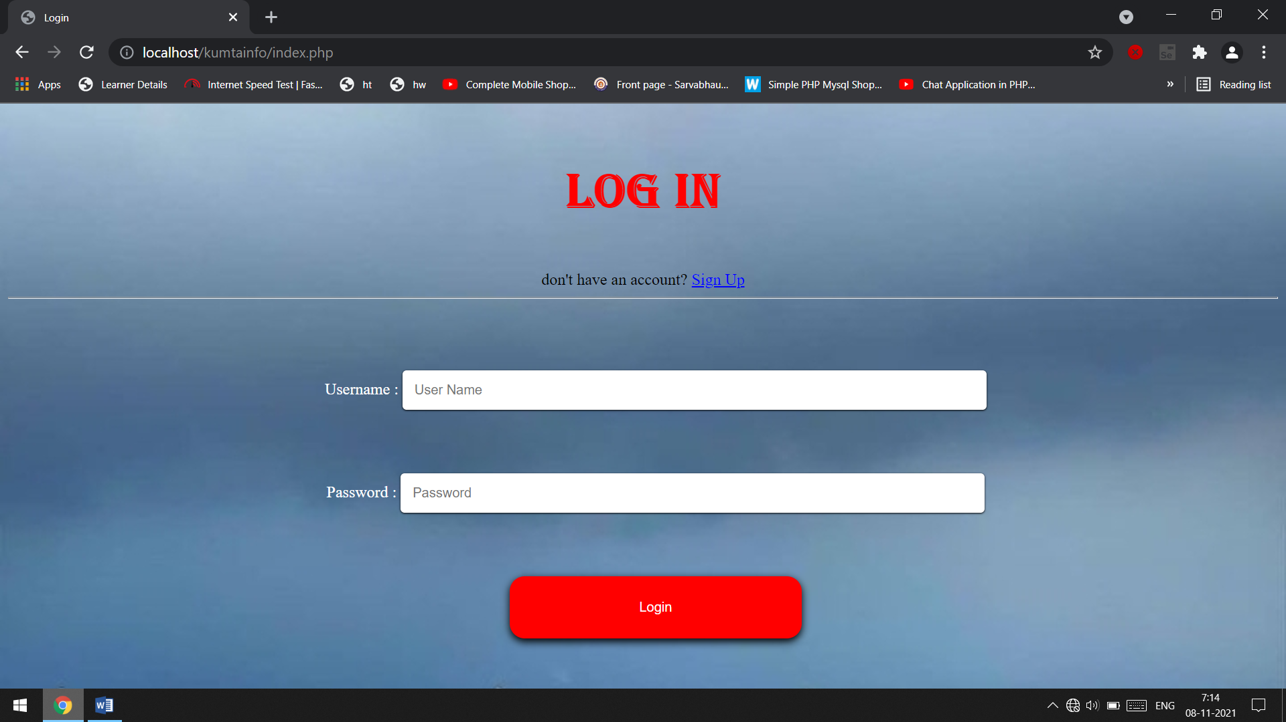
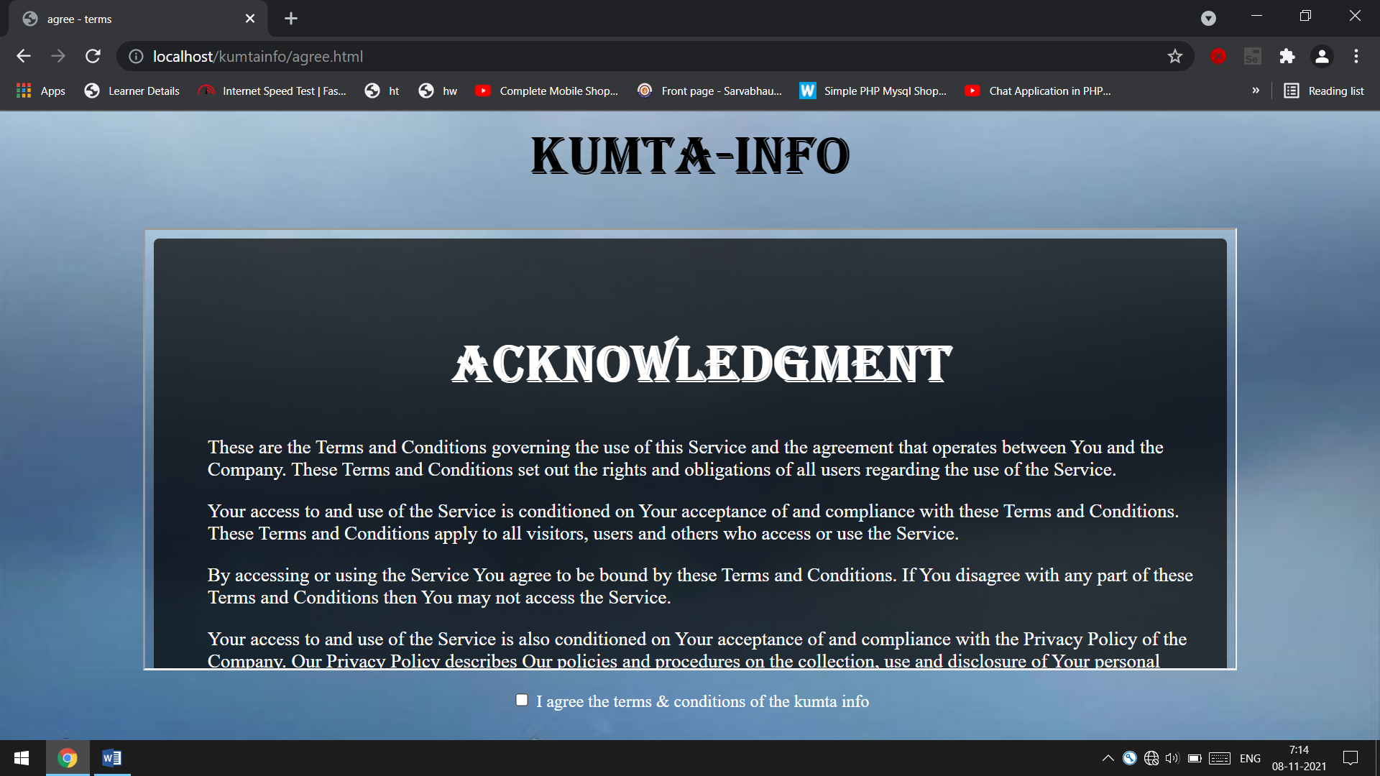
Outputs

Slide 8
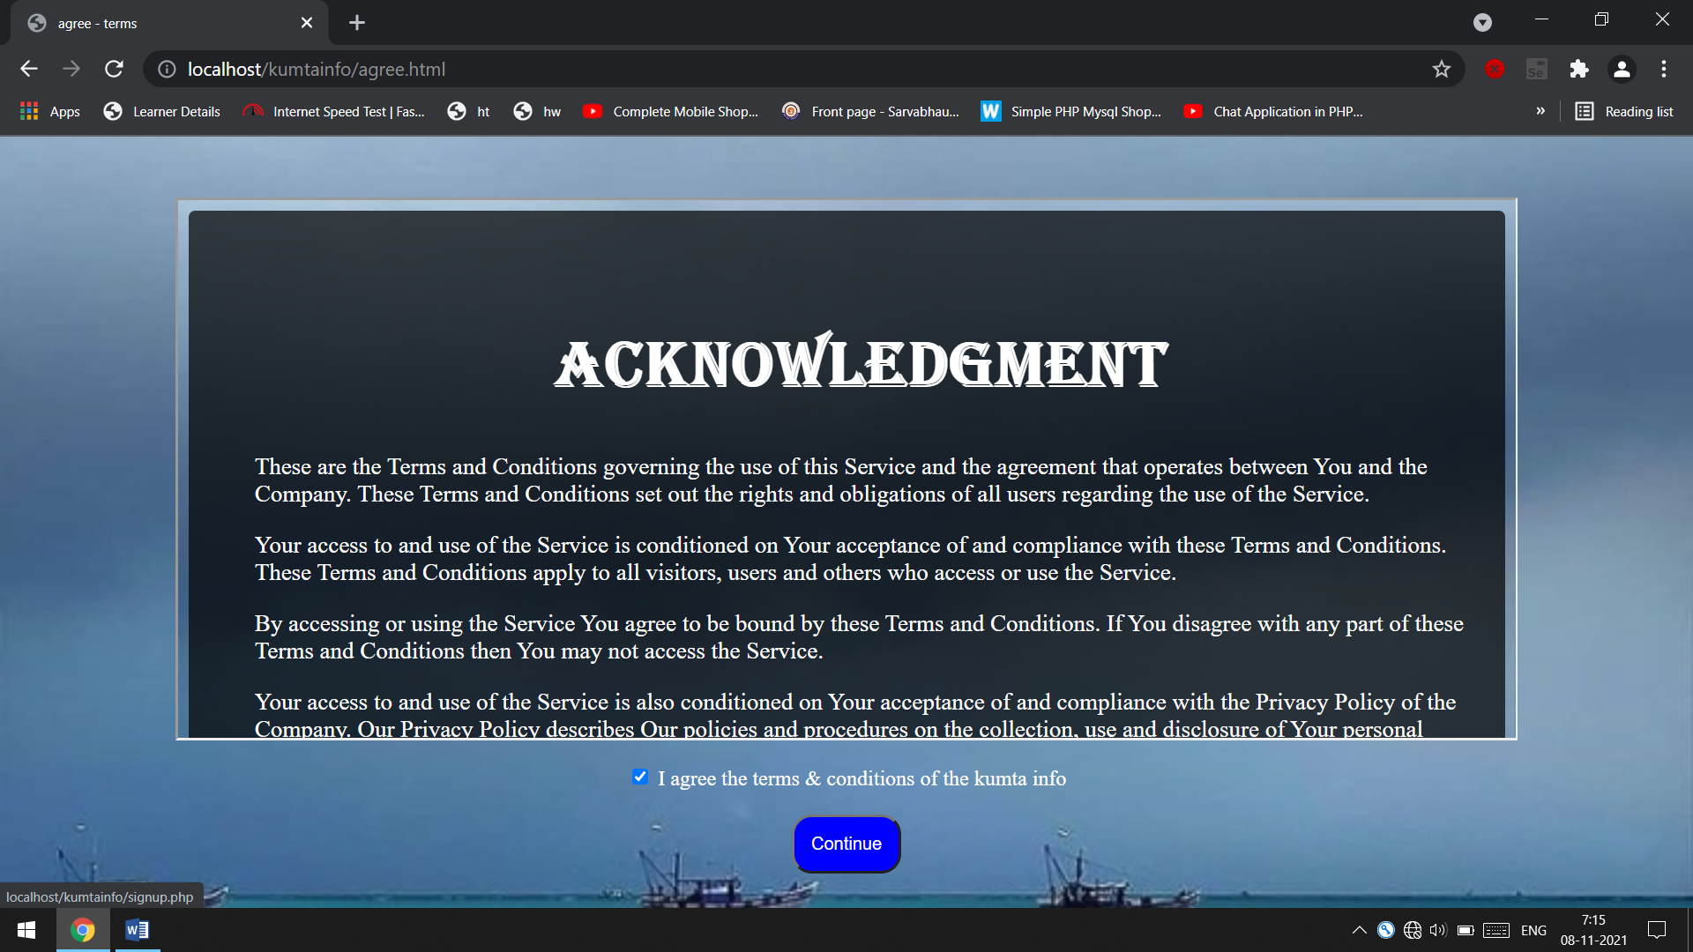
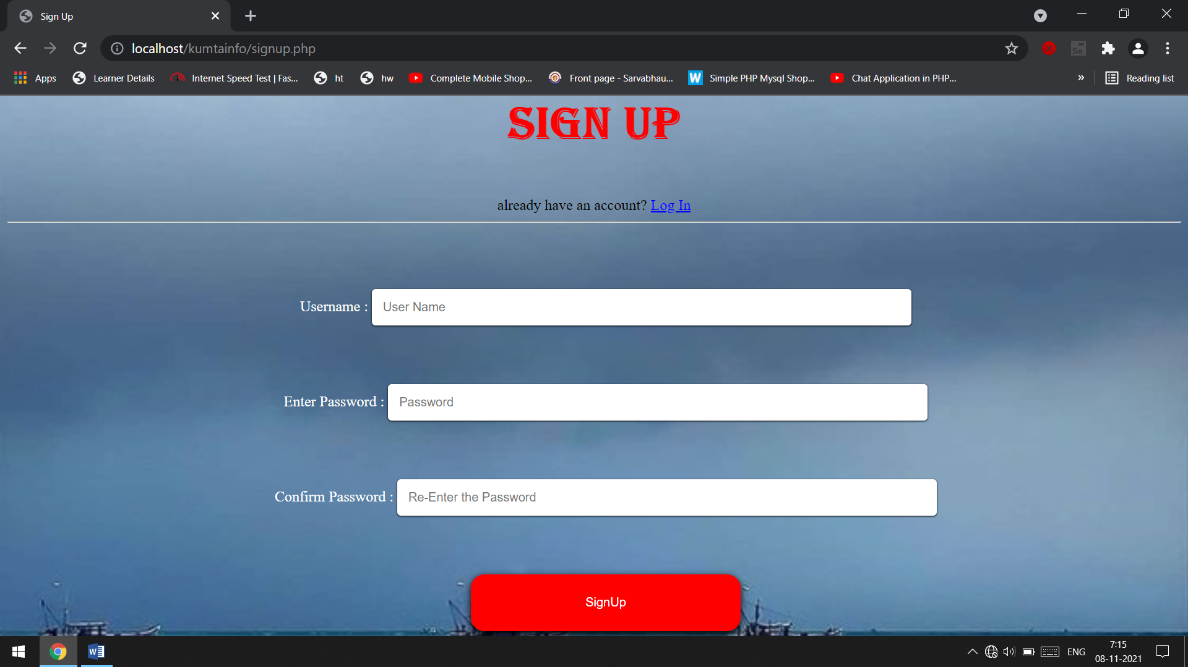

Slide 9
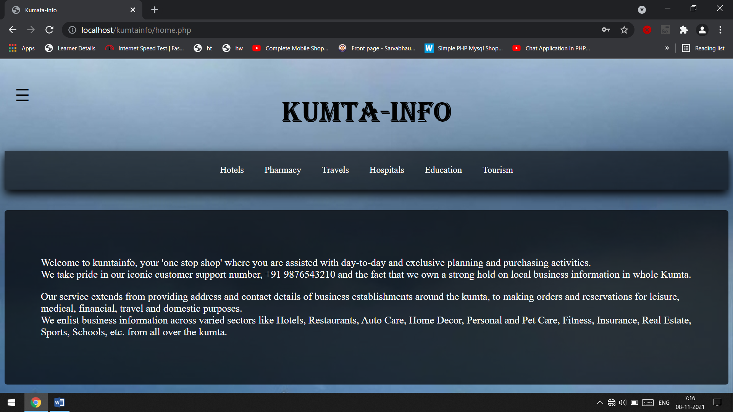
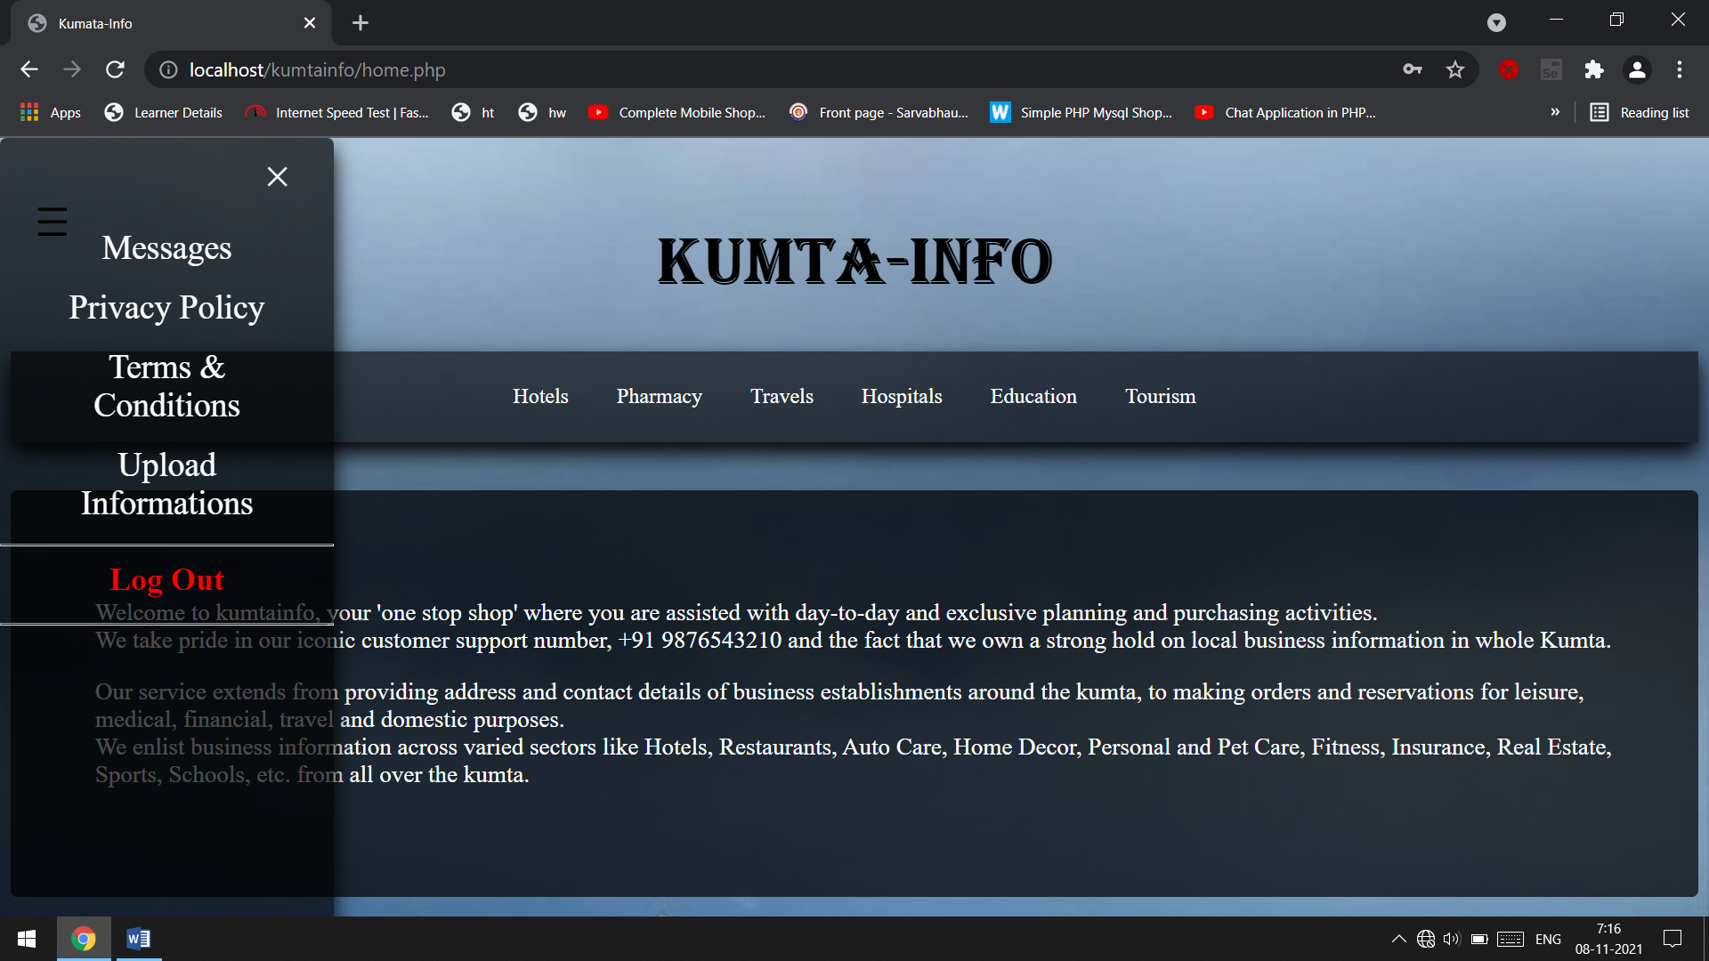

Slide 10
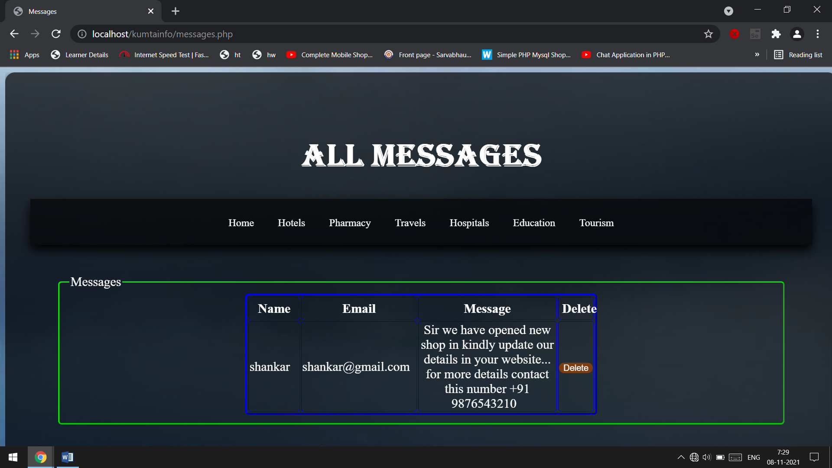
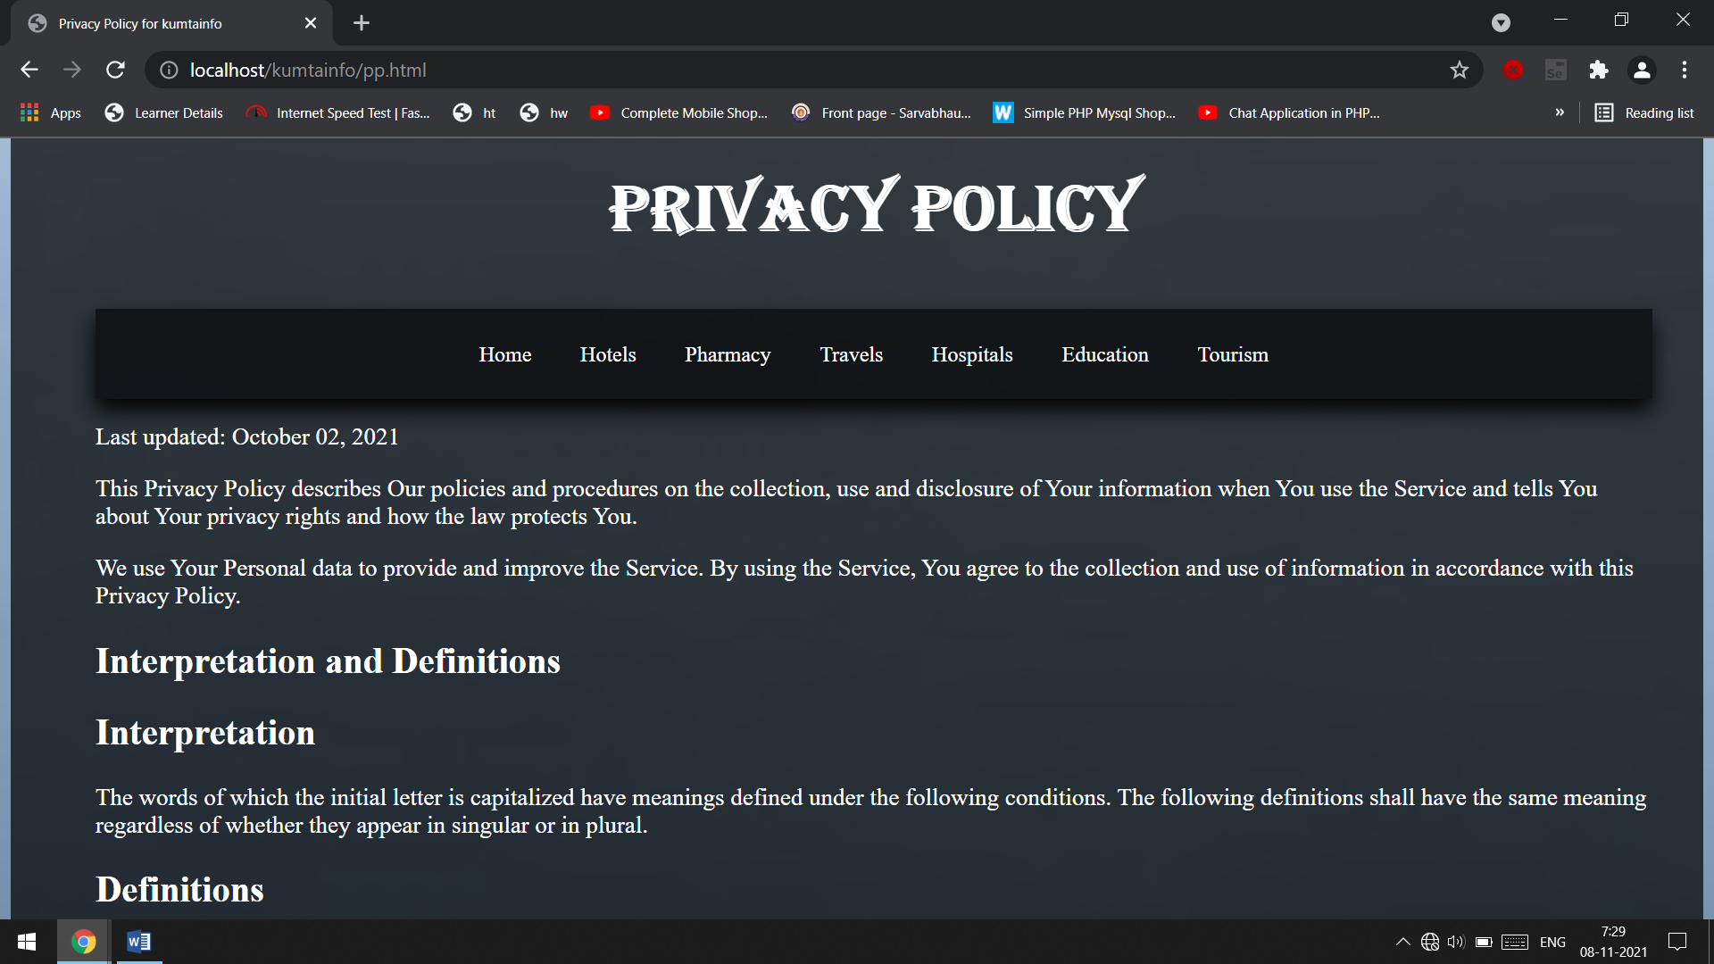

Slide 11
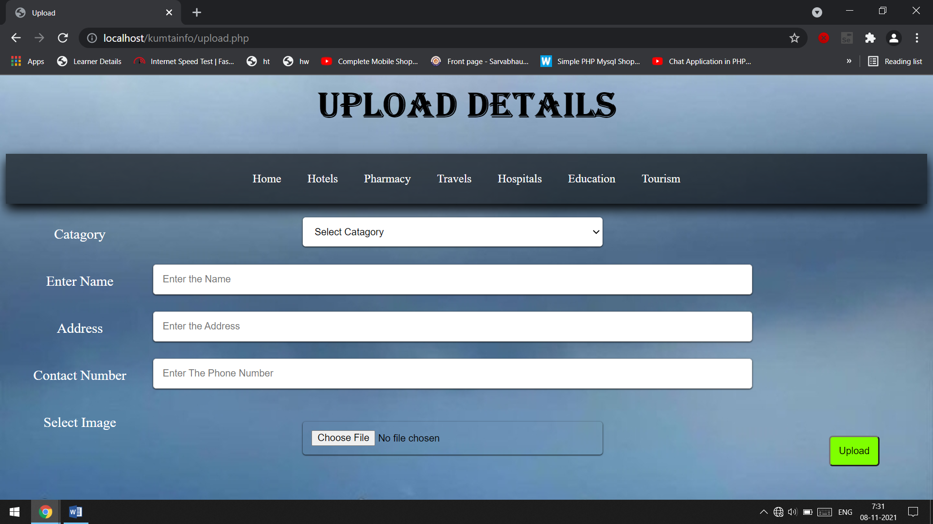
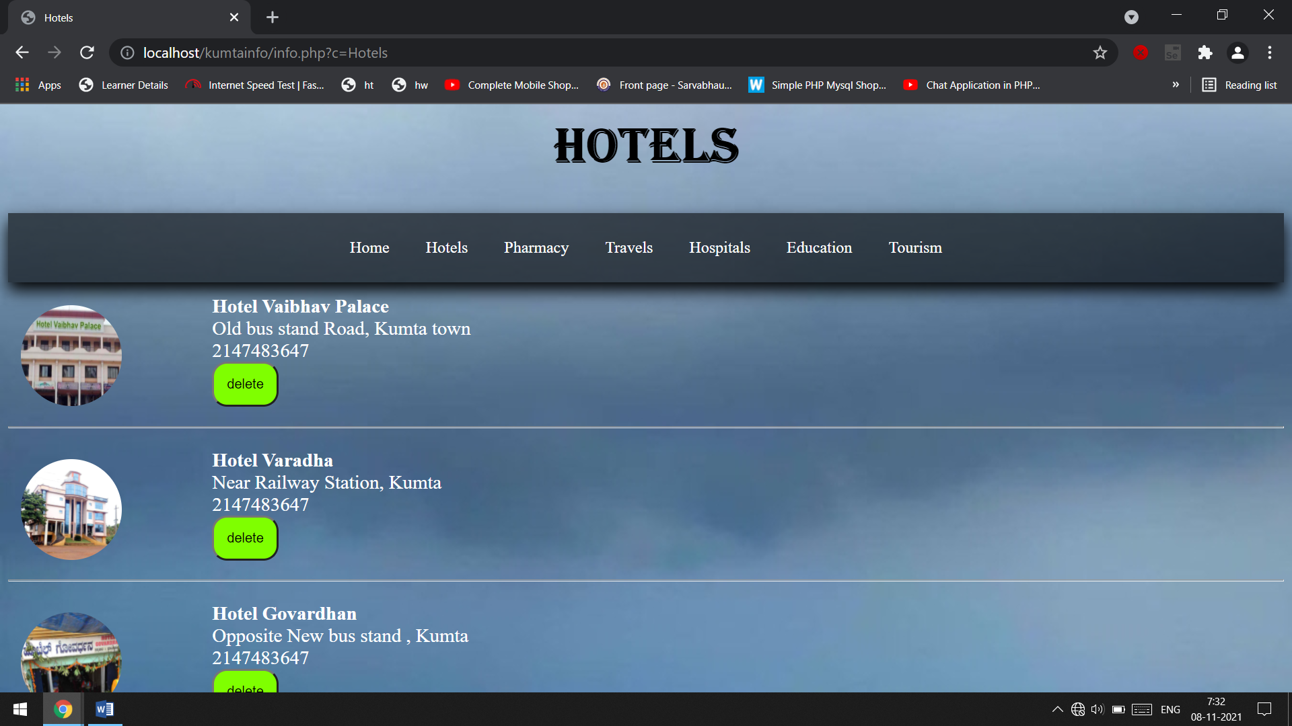

Slide 12
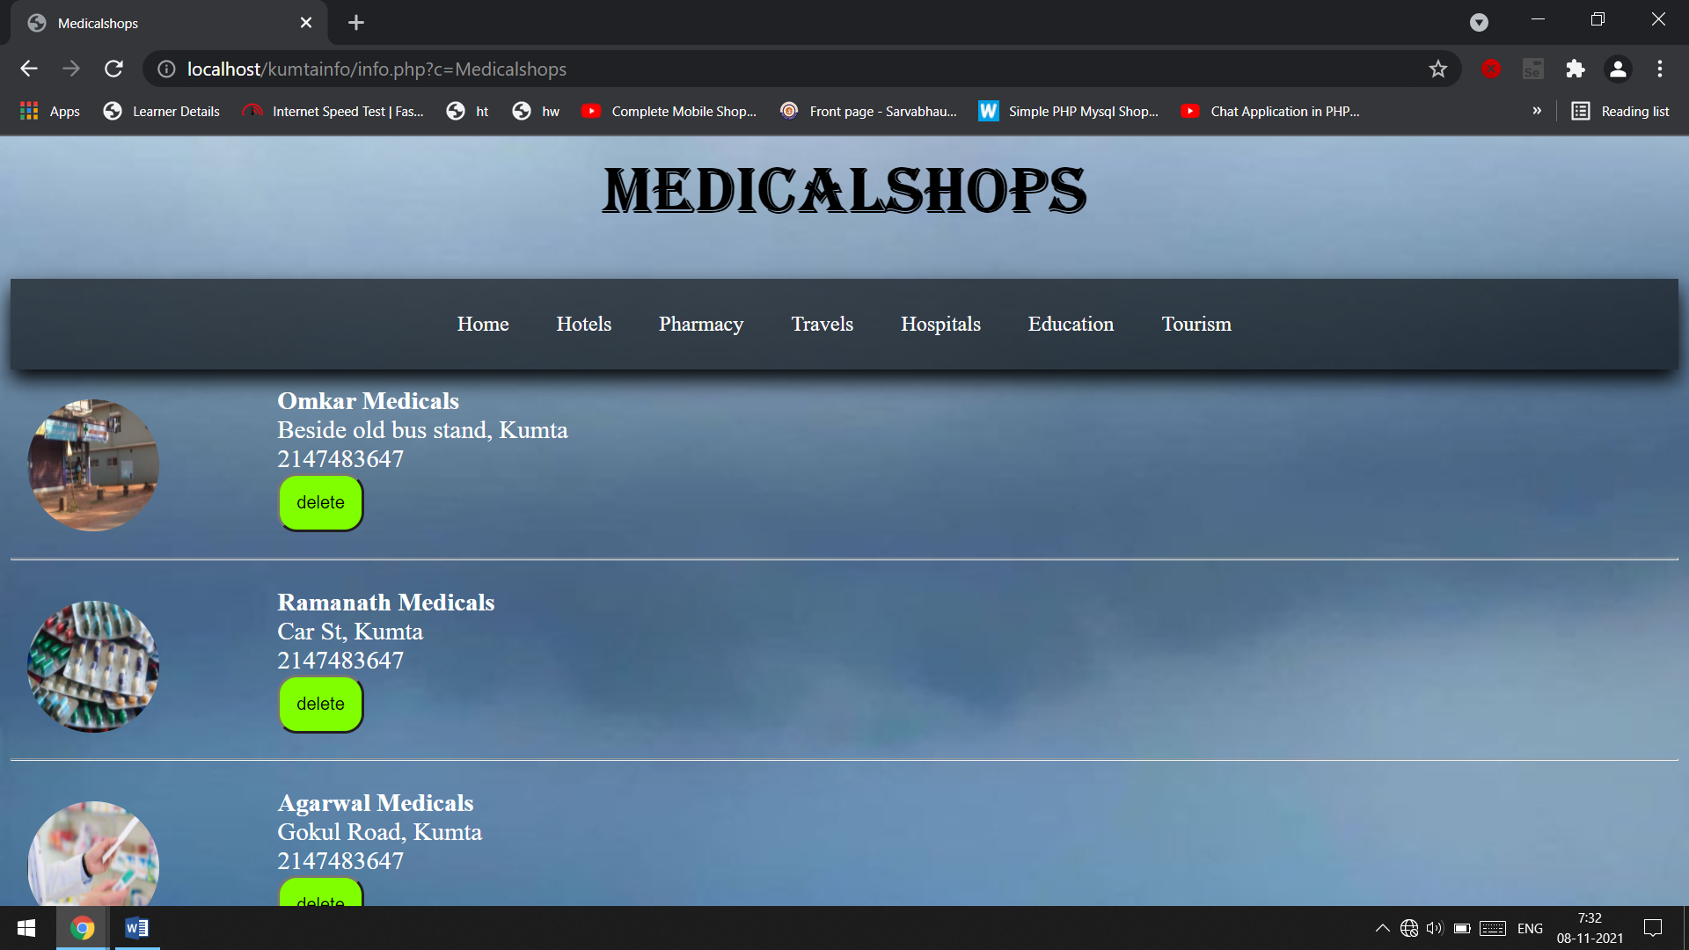
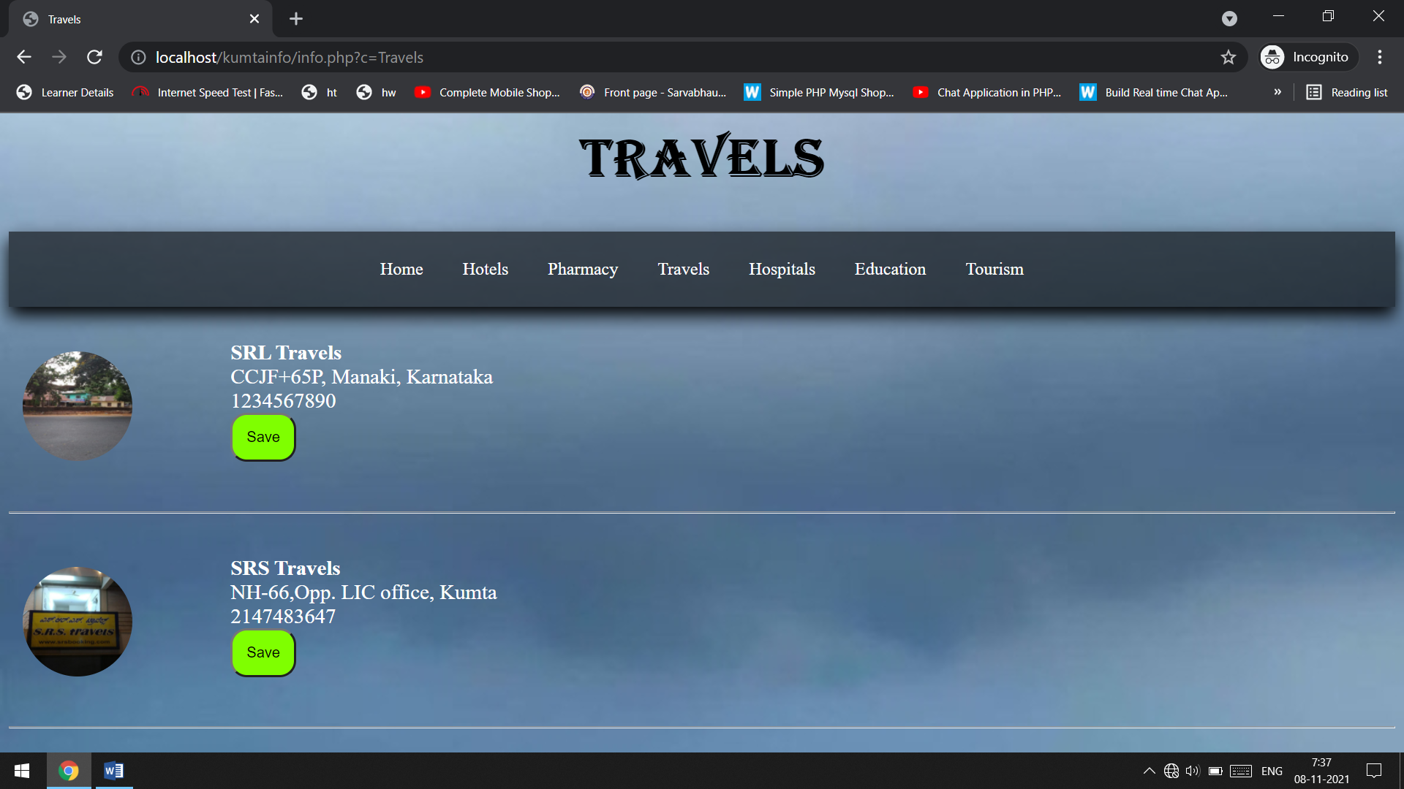

Slide 13
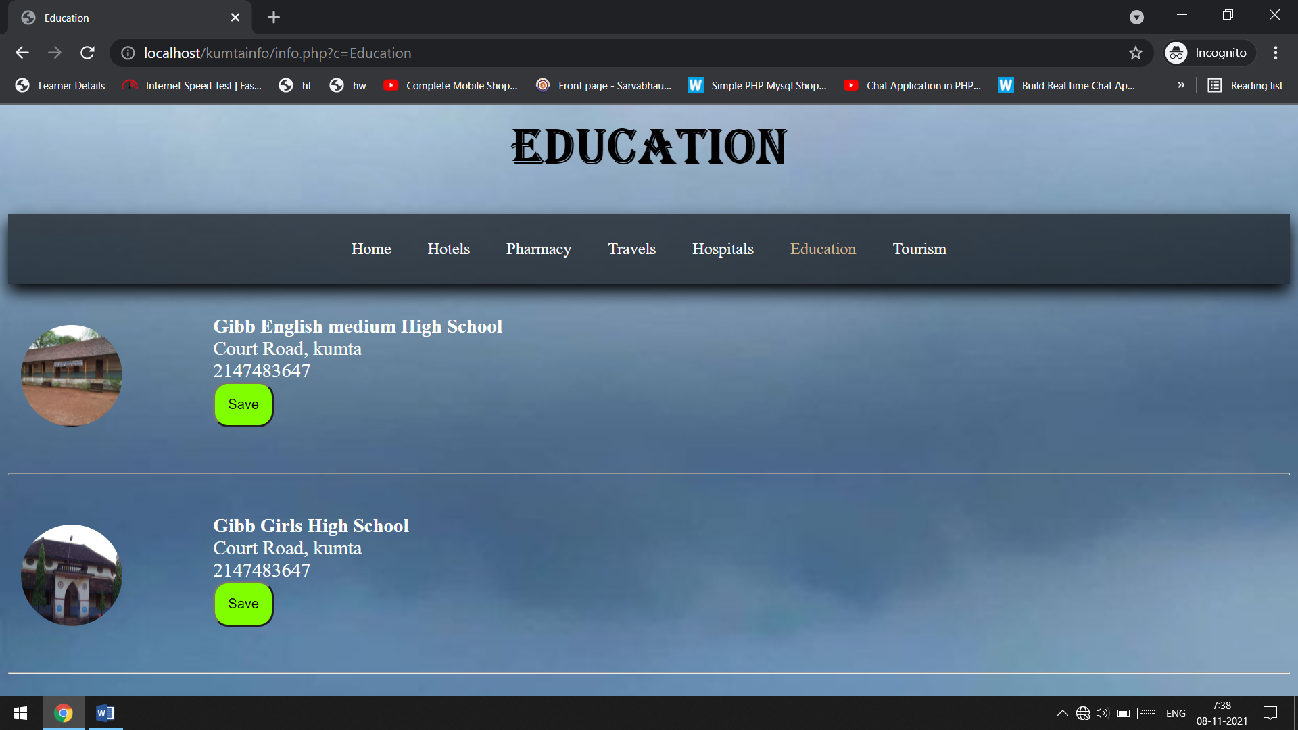
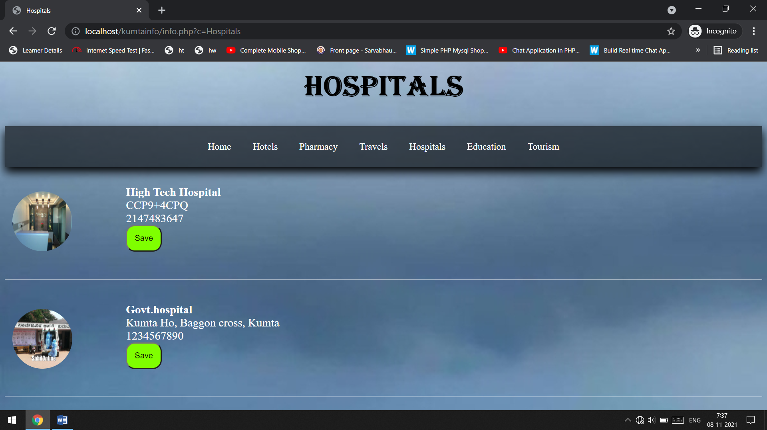

Slide 14
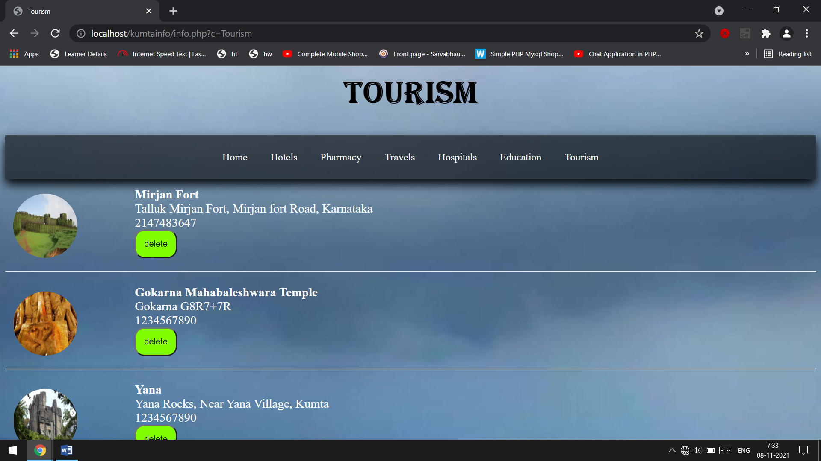
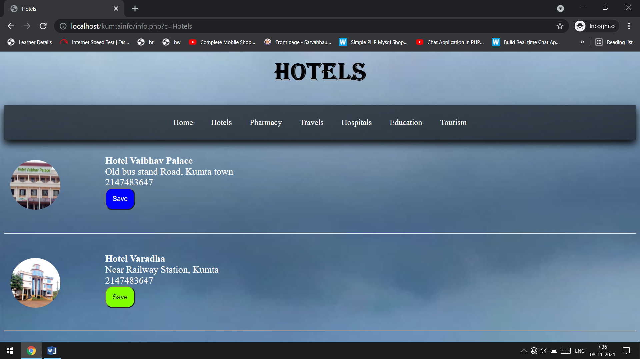

Slide 15
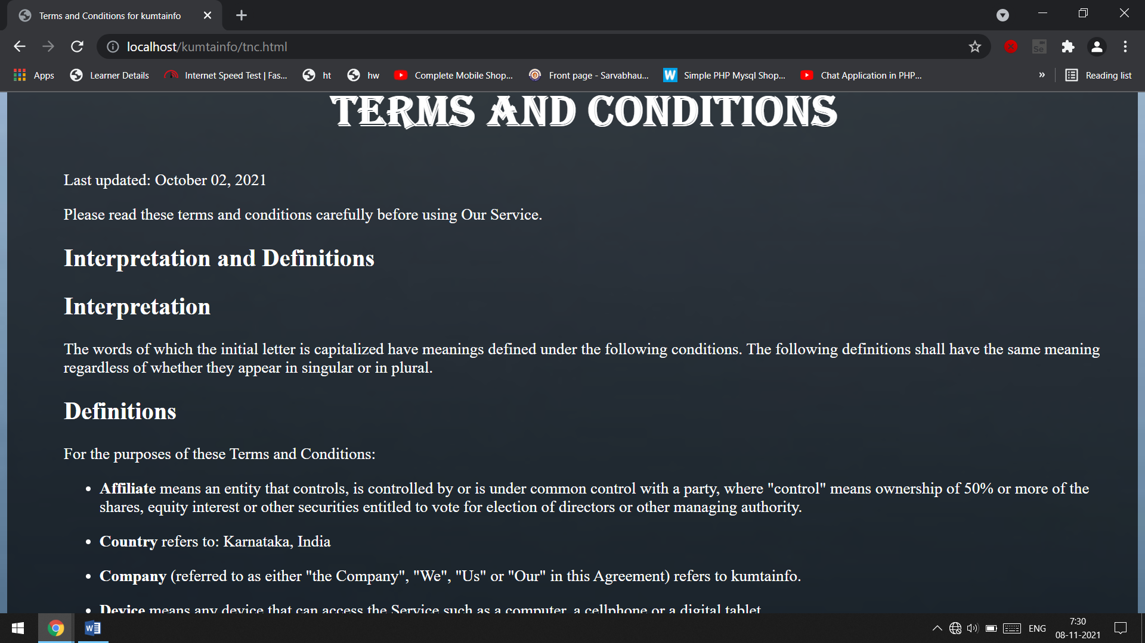
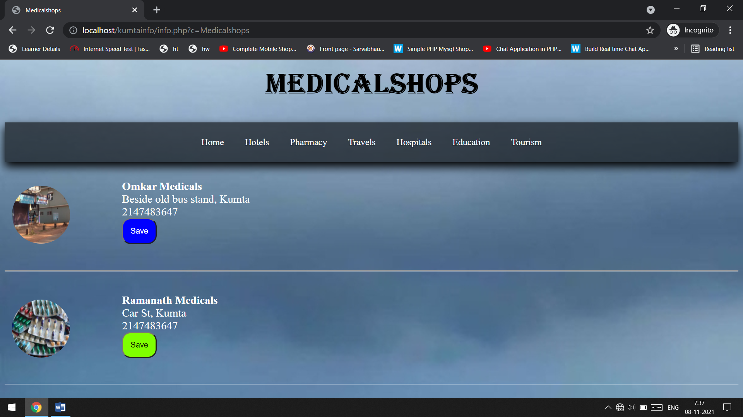

Slide 17
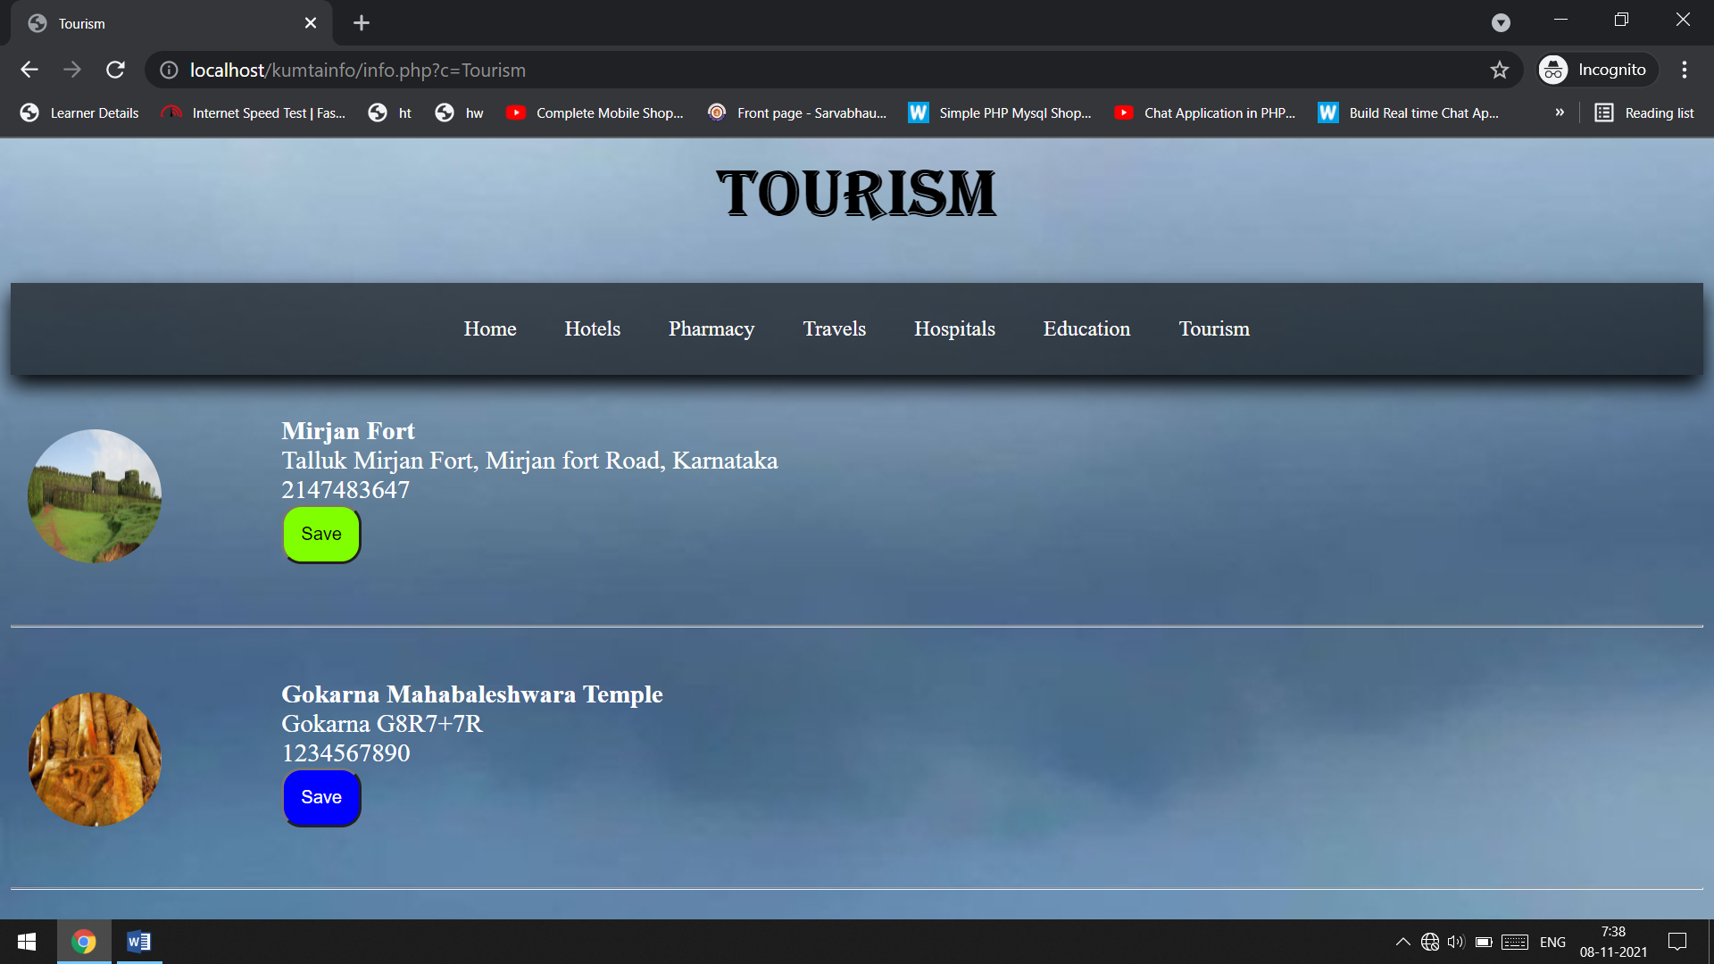

Slide 18
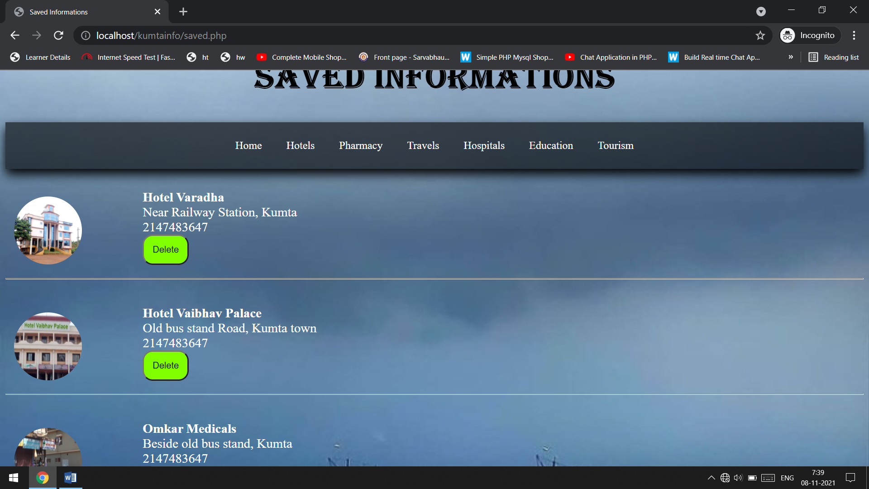
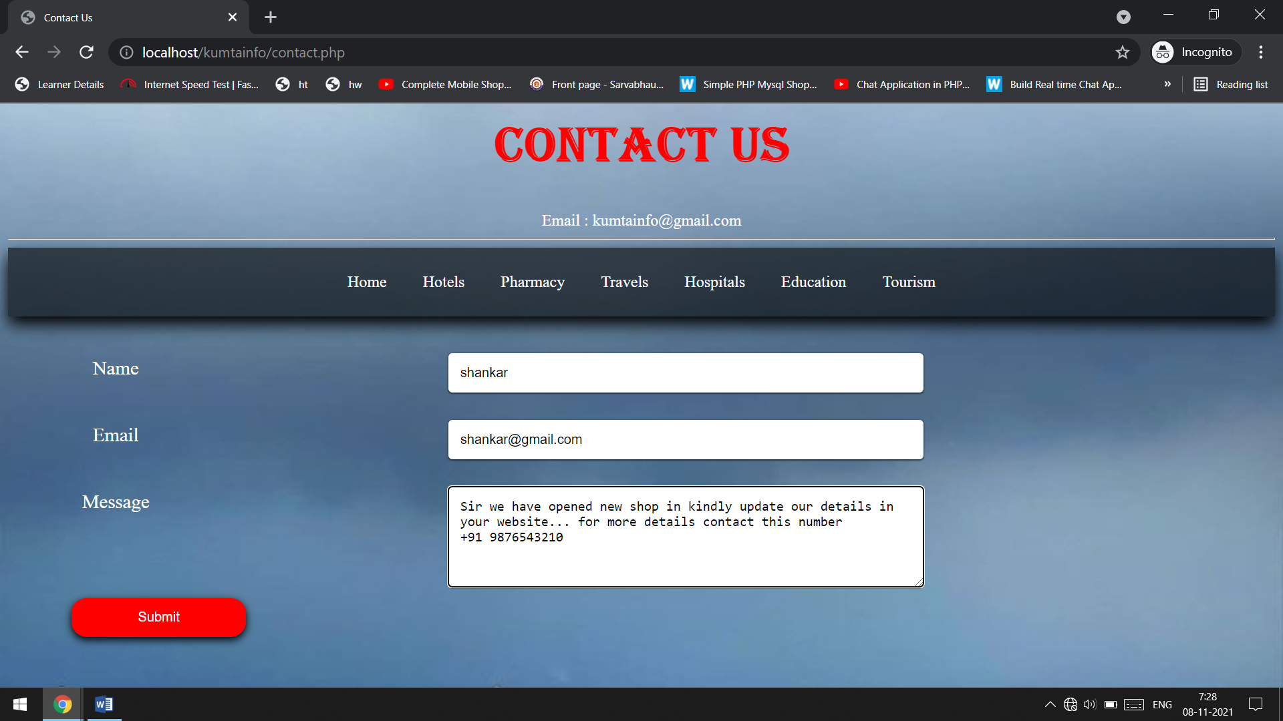

Slide 19
conclusion
The Kumta -info, for Windows allows users to search for services by attributes address and contact information . He /She can also save the information for the future references. Before going access the information user need to login page by accepting the terms and conditions. This is will be helpful for the people who need the information of kumta , In emergency condition they can access the hospitals and medical shops near Kumta . And this website will be useful for the tourists for searching the tourist places in Kumta . The people who wish to go for their destination they can book online ticket for their journey by accessing the information present in our website. There is information about the Schools which will be help for the parents for selecting the Schools which meets their requirements .
PREFACE:
First of all I would like to say that project is very essential part of our educational quota.If we are going only for theory parts, it cannot gives us perfect knowledge.
This project work “kumta-info” website is presents against you for project as subject in. This website is developed for study purpose of computer student .In this website it requires only registration for users which is also free.For that he/she should have an email account like Yahoo,Rediff,Hotmail,Gmail etc.This kumtainfo.com website is developed in programmimg language.
This website is quite easy in operating so that person can able to use it easily.
Your co-operate in form of suggestions and comments are most welcome to improve any knowledge and project.

